Slide 1
NFLX Stock Performance
Overview of 2017

Slide 2
NFLX Stock Performance
Stock Price Distribution
Netflix Revenue Comparison
Estimate versus Actual Earnings Per Share
Netflix stock against the Dow Jones Index
Smerling Rosario
Stock Profile Team Leader

Slide 3
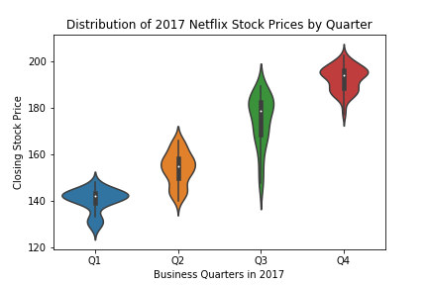
Stock Price Distribution
Netflix continues to have a positive quarterly growth throughout 2018. Although the third quarter also grew over the second quarter, it was also the quarter which had the greatest price variance.

Slide 4
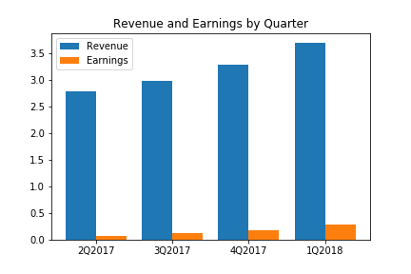
Netflix Revenue
Netflix earnings in comparison to it’s revenue is very low. The last quarter effected a 7.8% profit margin.

Slide 5
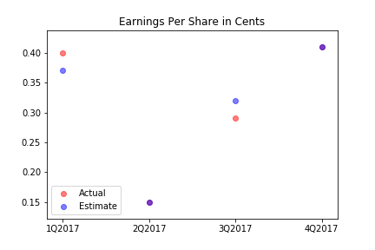
Estimate versus Actual Earnings Per Share
The per share earnings estimate of Yahoo Finance was significantly close to the actual share price each quarter; where the second and forth quarter estimate was actualized.

Slide 6
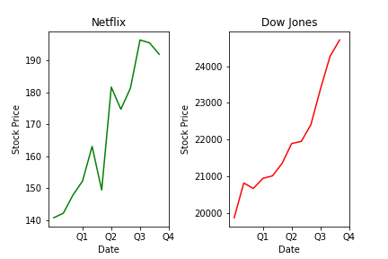
Netflix stock against the Dow Jones Index
Netflix stock behaved in a similar fashion as the Dow Jones Index in a mostly upward trend throughout the year. With the exception of June, which had a major dip in price not consistent with the Dow Jones

